Slide 1
Status Report
2015. 12. 14
Nam Jong Woo

Slide 2
Action Item
Background Estimation (update)
Normalization Factor (luminosity update)
Numbers
THStack
Efficiency-mass plot
Cross Section update

Slide 3
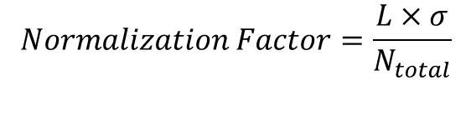
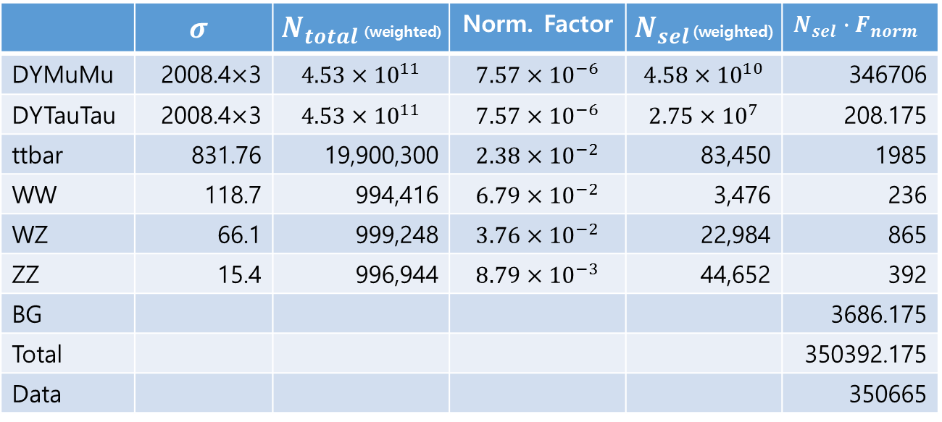
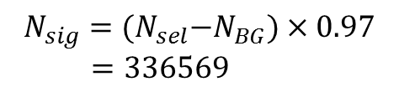
Normalization Factor
 | $$σ$$ | $N_{total}$(weighted) | Norm. Factor | $N_{sel}$(weighted) | $$N_{sel}∙F_{norm}$$
DYMuMu | 2008.4$×$3 | $$4.53×{10}^{11}$$ | $$7.57×{10}^{−6}$$ | $$4.58×{10}^{10}$$ | 346706
DYTauTau | 2008.4$×$3 | $$4.53×{10}^{11}$$ | $$7.57×{10}^{−6}$$ | $$2.75×{10}^{7}$$ | 208.175
ttbar | 831.76 | 19,900,300 | $$2.38×{10}^{−2}$$ | 83,450 | 1985
WW | 118.7 | 994,416 | $$6.79×{10}^{−2}$$ | 3,476 | 236
WZ | 66.1 | 999,248 | $$3.76×{10}^{−2}$$ | 22,984 | 865
ZZ | 15.4 | 996,944 | $$8.79×{10}^{−3}$$ | 44,652 | 392
BG |  |  |  |  | 3686.175
Total |  |  |  |  | 350392.175
Data |  |  |  |  | 350665
$$Normalization Factor=\frac{L×σ}{N_{total}}$$
$$N_{sig}={(N}_{sel}−N_{BG})×0.97$$
$=336569$

Slide 4
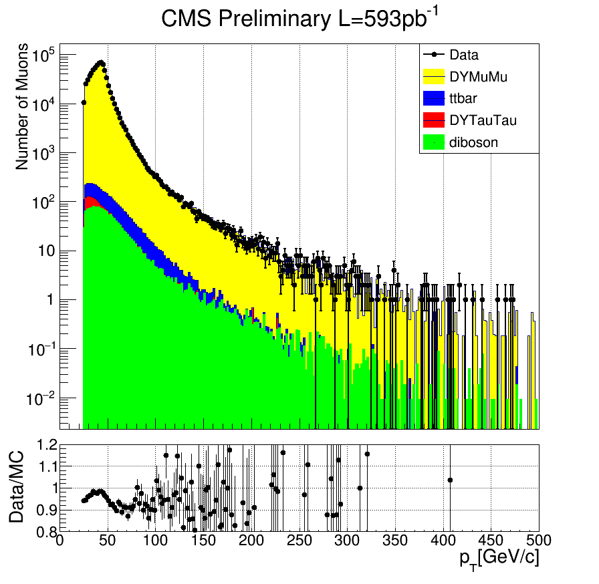
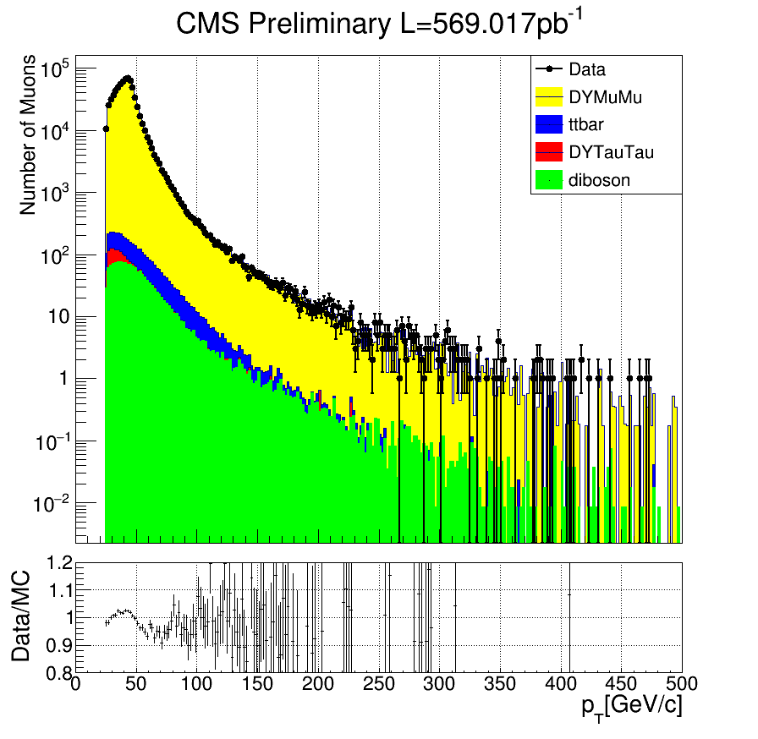

THStack $p_{T}$
DYMuMu | 346706
ttbar | 1985
DYTauTau | 208.175
Diboson | 1493
(before)

Slide 5
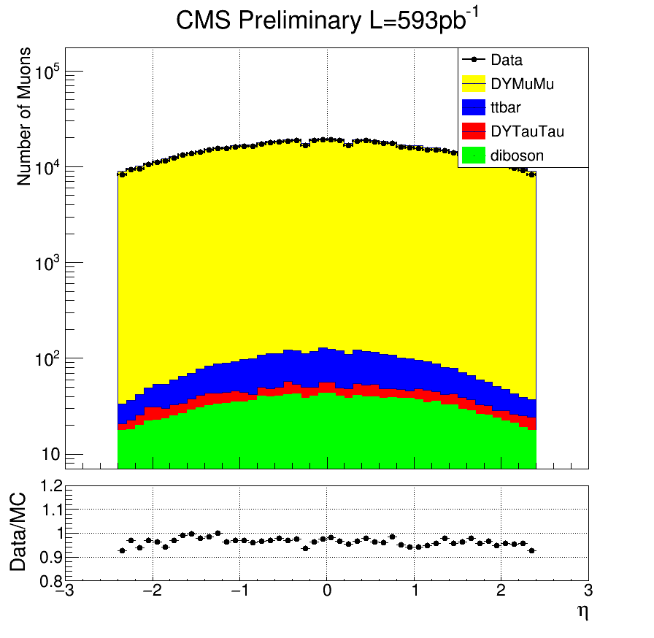
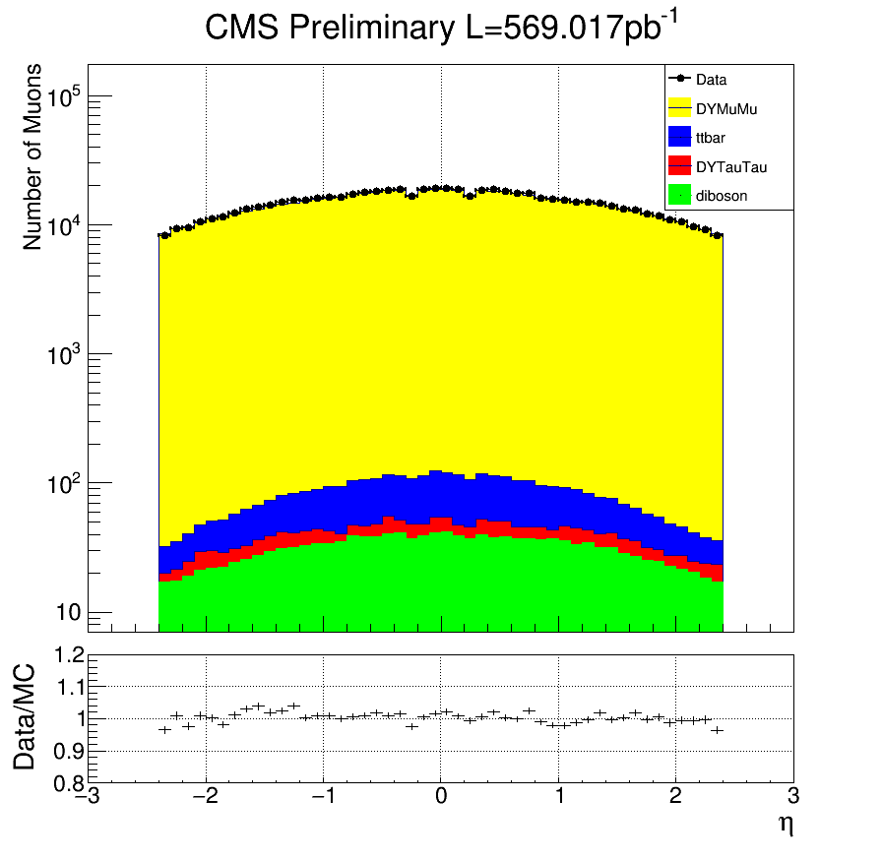

THStack $η$
DYMuMu | 346706
ttbar | 1985
DYTauTau | 208.175
Diboson | 1493
(before)

Slide 6
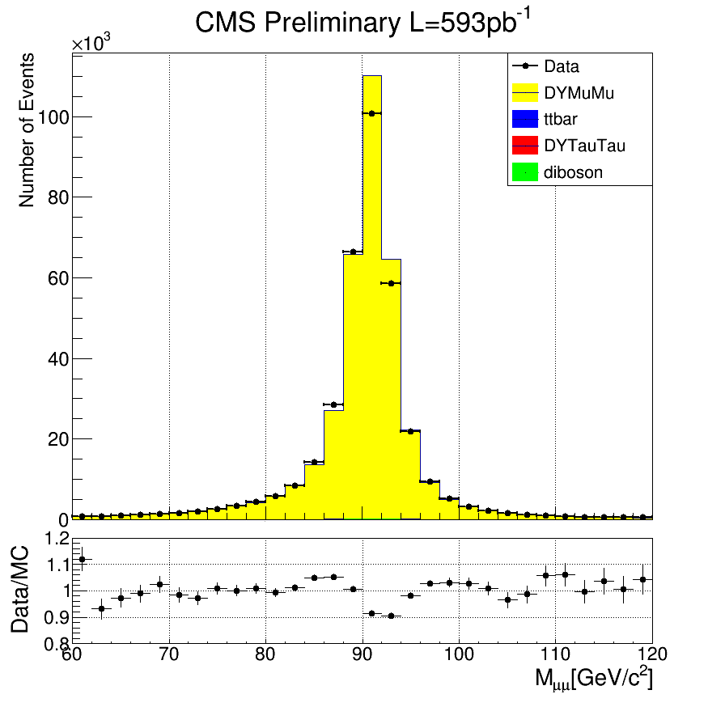
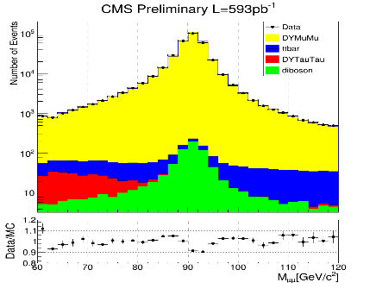
THStack mass
DYMuMu | 173353
ttbar | 992.5
DYTauTau | 104.088
Diboson | 746.5

Slide 7
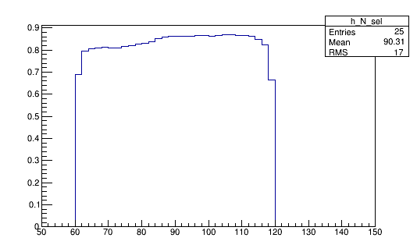
Efficiency-mass plot
Eff.
mass(GeV)

Slide 8
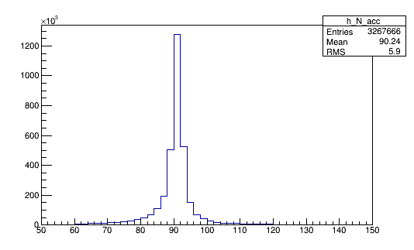
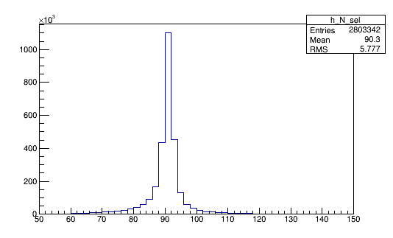
Accepted events
mass(GeV)
Selected events
mass(GeV)

Slide 9

Cross section update
Luminosity = 592.563
Acceptance = 0.359
Efficiency = 0.858
$σ=1844.051±3.788\left(stat.\right)±184.405(lum.)$
($σ_{th}=1868$)

